Slide 1
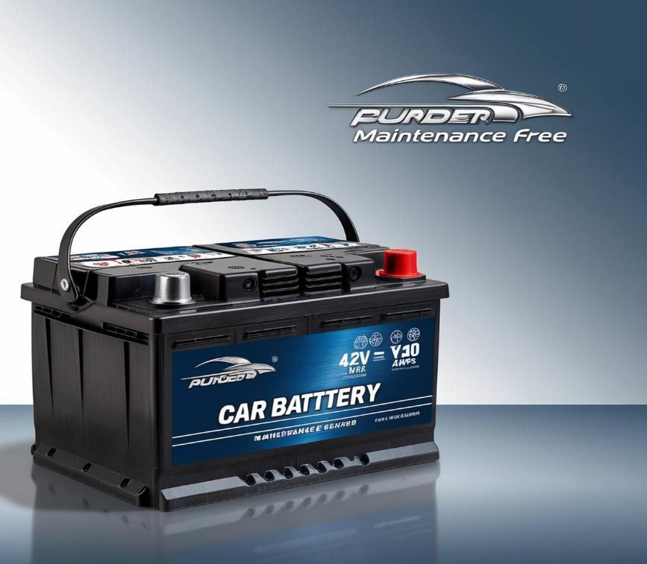
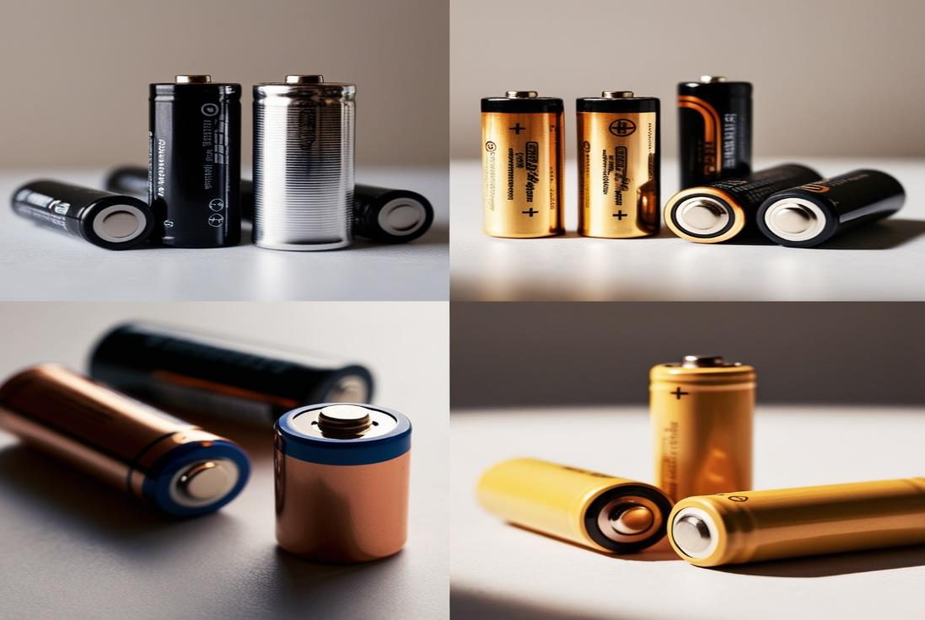
Battery :-
Name :- Mayank Kumar Roll No. :- 021330024330 Batch :- Bill Gates 2024

Slide 2
Introduction :-
1
Batteries are devices that store chemical energy and convert it into electrical energy, providing a portable and convenient source of power for a wide range of applications. They come in various types, each designed for specific uses, and are integral to modern technology.
2
Alkaline Batteries :- Commonly used in household items like remote controls and clocks. They are disposable and known for their long shelf life.
3
Lithium-Ion Batteries :- Widely used in portable electronics such as smartphones, laptops, and electric vehicles due to their high energy density and rechargeability.

Slide 3
Lithium
Nickel
Steel
Graphite
Raw materials
Electrolytes
Copper
Aluminum
Lead

Slide 4
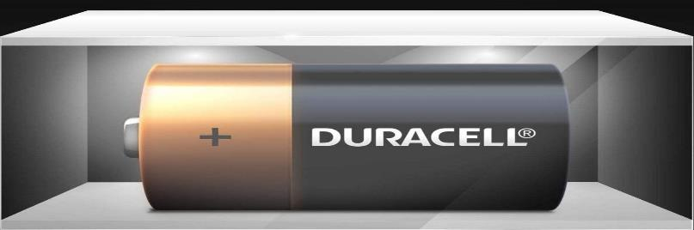
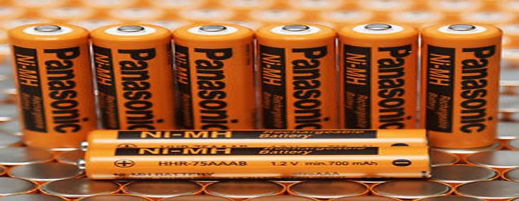
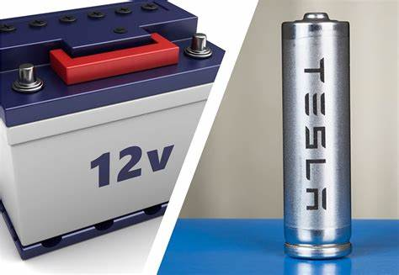
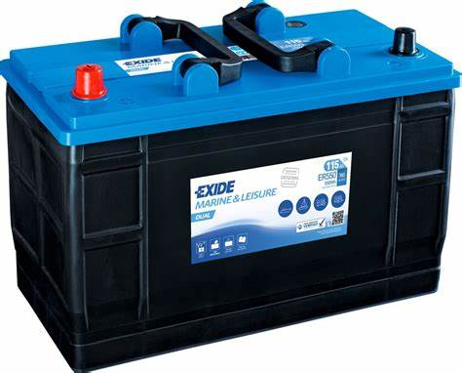
Duracell :-
Products :- Alkaline batteries, rechargeable batteries, specialty batteries.
Applications :- Household devices, toys, remote controls, flashlights.
Panasonic :-
Products :- Alkaline batteries, lithium batteries, rechargeable batteries, rechargeable series.
Applications :- Consumer electronics, household devices, cameras
01
03
Tesla :-
Products :- Lithium-ion battery packs (in-house and in partnership with Panasonic).
Applications :- Electric vehicles, energy storage systems (Powerwall, Powerpack).
02
Exide :-
Products :- Lead-acid batteries, AGM batteries, EFB batteries.
Applications :- Automotive, industrial, marine, backup power.
04

Slide 5
Coating Machines :-
Coat the electrode slurry onto current collectors (copper for anodes, aluminum for cathodes).
Welders :-
Enclosure Machines :-
Encapsulate the cells in protective housings.
Labeling Machines :-
Add labels and other necessary information to the battery products.
Winding Machines and Stacking Machines :-
Winding :- Roll electrodes and separators into cylindrical shapes/cells.
Stacking :- Stack electrodes and separators in layers (for pouch and prismatic cells).
02
04
01
03
05
Slitting Machines :-
Cut the large sheets of electrodes into smaller, precise sizes for cell assembly..
Formation Equipment :-
Perform initial charge and discharge cycles to form the solid-electrolyte interface (SEI) layer.

Slide 6
Transformation process :-
Raw Material Procurement :-
Sourcing Materials
Supplier Selection
Contract Management
1.
Inbound Logistics :-
Transportation
Inventory Management
Warehousing
2.
3.
Manufacturing Process :-
Preparation
Electrode Manufacturing
Cell Assembly
Formation and Aging
Quality Control :-
In-Process Inspections
End-of-Line Testing
Quality Assurance
4.
Outbound Logistics :-
Packaging
Distribution Centers
Transportation
5.
Inventory Management :-
Demand Forecasting
Inventory Levels
Reorder Points
6.
Supplier Relationship Management :-
Communication
Performance Evaluation
Collaboration
7.
Production Planning and Scheduling :-
Capacity Planning
Scheduling
Lean Manufacturing
8.
Risk Management :-
Supply Chain Risks
Contingency Planning
9.
Continuous Improvement :-
Feedback Loop
Innovation
10.
Technology and Automation :-
Automation
Data Analytics
11.

Slide 7
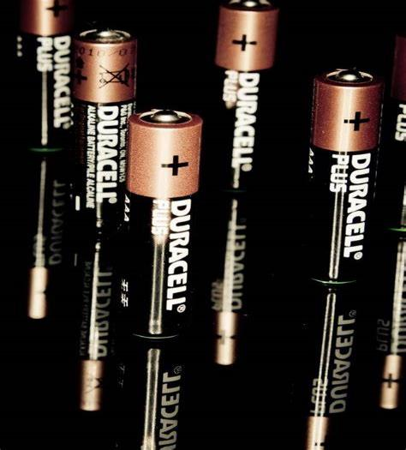
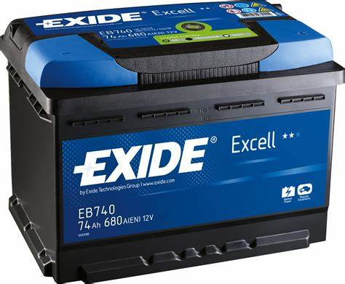
Finished Product :-
A finished product battery is the final result of a detailed manufacturing process, ensuring it performs well and lasts a long time. These batteries go through thorough testing to guarantee they are safe and efficient. Made from advanced materials and technology, they provide reliable power for many uses, from gadgets to industrial machines.
The entire process from raw material preparation to the final product ready for shipment can take anywhere from 2 to 4 weeks, depending on the type of battery and the efficiency of the production line.

Slide 8
Organization and Safety
Inventory management
Protection and Compliance
Automation and Inspection
Demand forecasting
Reorder systems
Packaging
Warehousing
Inventory
management
Material
Management
Transportation
Logistics and Safety
Compliance
Procurement and Storage
Inventory Control

Slide 9
Conclusion :-
Efficient battery production and supply chain management involve a comprehensive process encompassing raw material procurement, precise manufacturing techniques, stringent quality control, and strategic logistics. By sourcing high-quality materials, implementing automated and lean manufacturing processes, and maintaining robust inventory and supplier relationships, companies can ensure the production of reliable and safe batteries for various applications. Continuous improvement through innovation and sustainability practices, along with the use of advanced technologies, allows companies to stay competitive, meet market demands, and contribute positively to the environment.

